Slide 1
Online Food Delivery System
By Group 4
Id | Name
2491361 | Kulkarni Sampada Sunilrao
2490795 | Bolleddulla Karthik Babu
2491196 | Indrayudh Dasgupta
2487464 | Mittapalli Sahithi Priya
2491169 | Perike Pavan Kumar
2490872 | Aishwarya Walmik Dhumane
2490188 | Gunthapalli Lochan Aravind Akash
2489203 | Kamaljyothi Battula
2490669 | N Aswini
2490615 | Prateek Prashant Awate

Slide 2
Contents
Abstract
Introduction
Project Objective
Scope and Purpose
Tools and Technologies
Functional Requirements and Modules
ER Diagram
User Interface page Screenshots
Back-End Development
Advantages
Future Scope
Conclusion

Slide 3
Abstract
Foodie Time is a restaurant chain that delivers food items of different cuisines at affordable prices. It was established in 2014.It had been serving fine all these years; however, the business analysts noticed a decline in sales since 2016. They found out that online ordering of food items with companies, such as Swiggy and Foodpanda are gaining more profits by eliminating middlemen from the equation. As a result, the team decided to hire a Full Stack developer to develop an online food delivery web application with a rich and user-friendly interface. You are hired as the Full Stack Java developer and are asked to develop the web application. The management team has provided you with the requirements and their business model so that you can easily arrange different components of the application.

Slide 4
Introduction
The labor rates are increasing steadily year on year thus making it difficult to find employees. The food industry is highly labor intensive and the biggest expense in the food industry is the cost of employing the right kind of people to do the work. One of the ways to reduce this expense is to use modern technology to replace some of the jobs done by human beings and make machines do the work. Here we propose an “Online Food Ordering System” that has been designed for Fast Food restaurant, Take-Out or College Cafeterias. The system can also be used in any food delivery industry. This simplifies the process of food ordering for both the customer and the restaurant, as the entire process of taking orders is automated.

Slide 5
Project Objective
Create a dynamic and responsive Angular UI/UX food delivery application for online ordering of food items of different cuisines from a restaurant.

Slide 6
Scope and Purpose
To provide a bug-free Online Food Delivery system to Users as well as Admin.
The main objective is here to provide a nice and secure platform for Ordering Food.
To maintain the records of Product, Category available into the system.

Slide 7
Tools and Technologies
Front End-
Angular
Back End-
JSON

Slide 8
Functional Requirements and Modules
Admin User: The admin user should be able to:
Login to portal
Add or remove cuisines to or from the application to build a rich product line
End User: The end user must be able to:
Register to the application
Sign into the application to maintain the record of activities
Search for food items based on the search keyword
Apply filters and sort results based on different cuisines to get the best deals
Add all the selected food items to a cart and customize the purchase at the end
Perform a seamless payment process

Slide 9
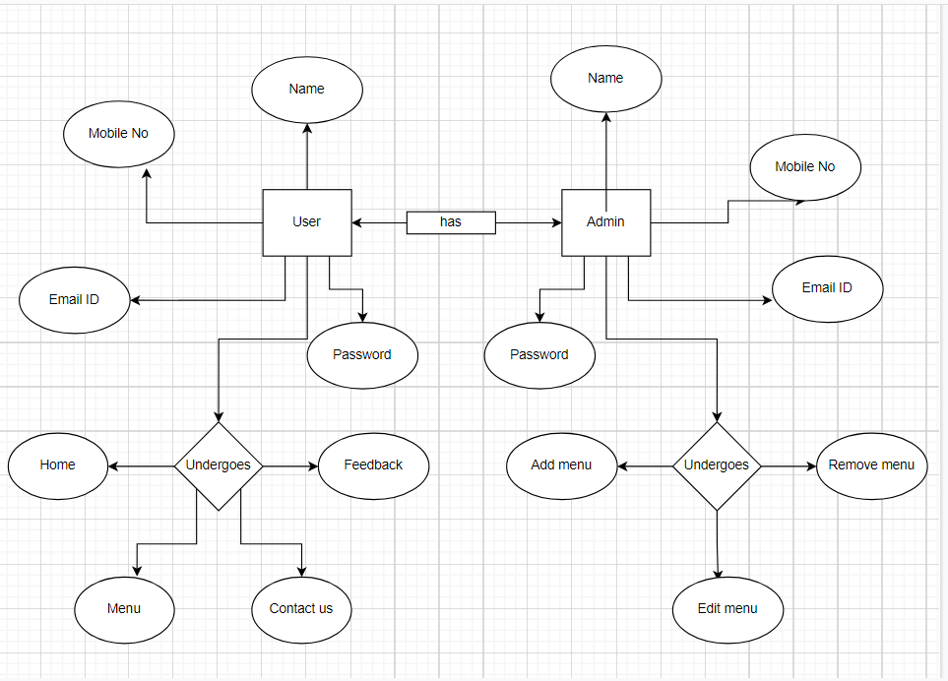
ER Diagram

Slide 10
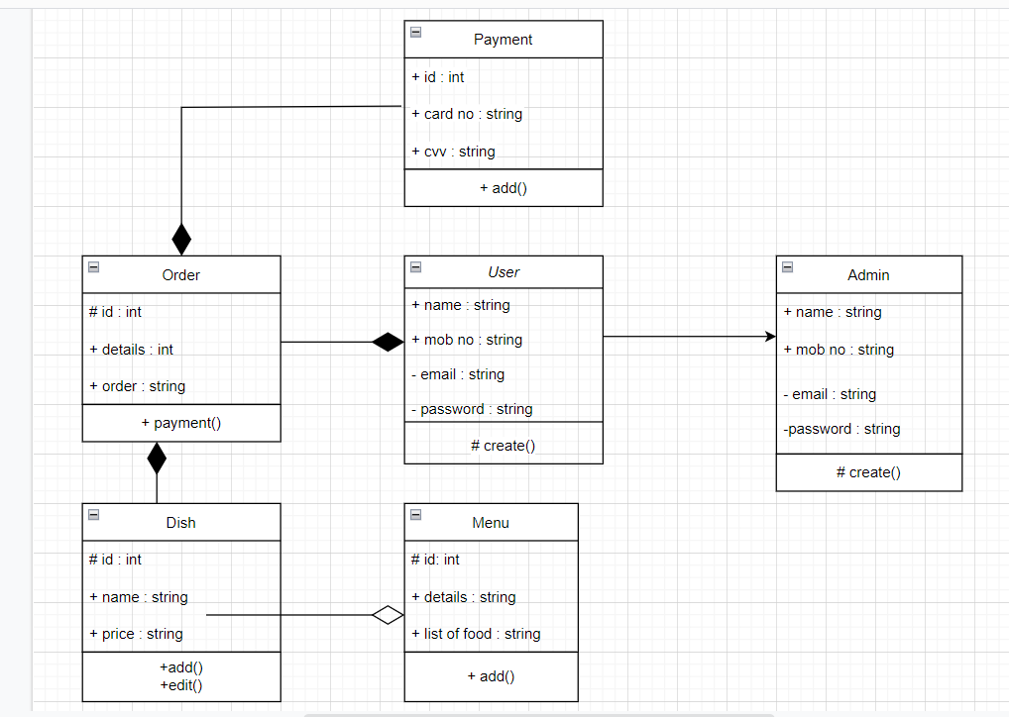
ER Diagram

Slide 11
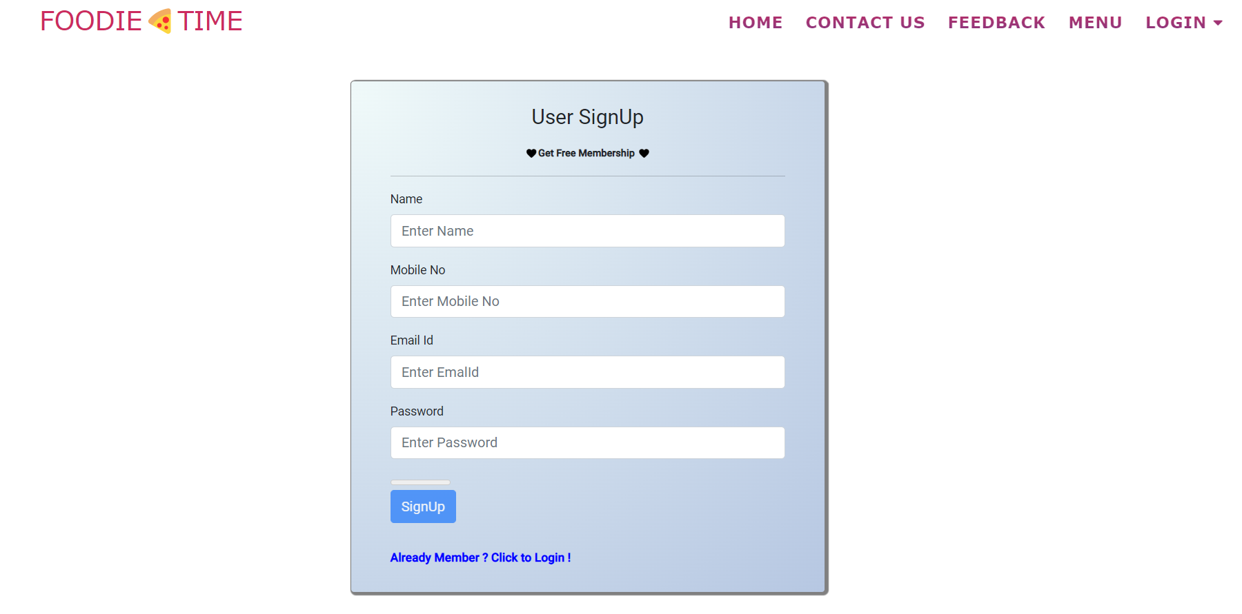
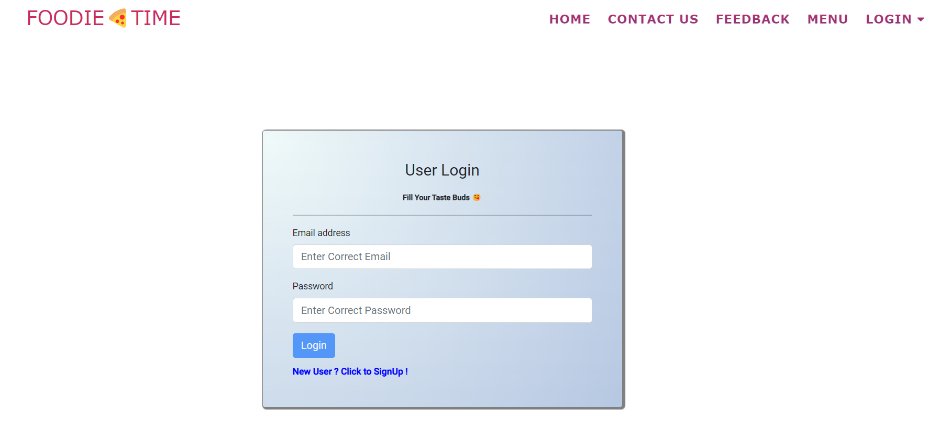
User Interface Page Screenshots

Slide 12
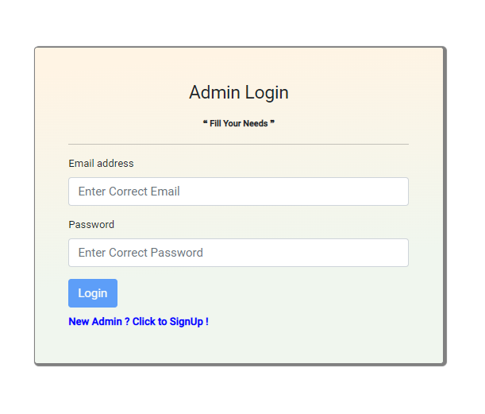
Admin Interface Page Screenshots

Slide 13
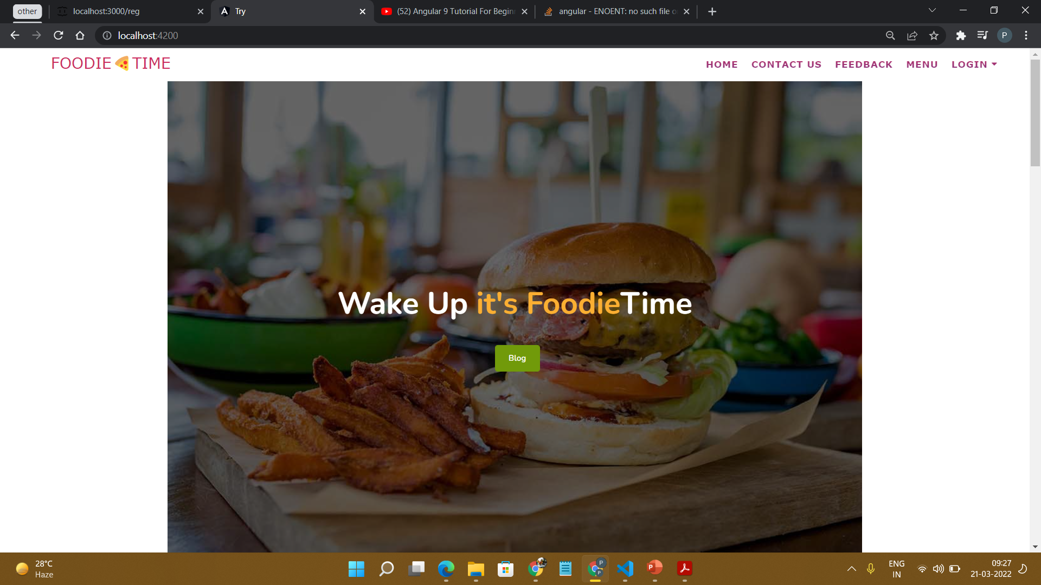
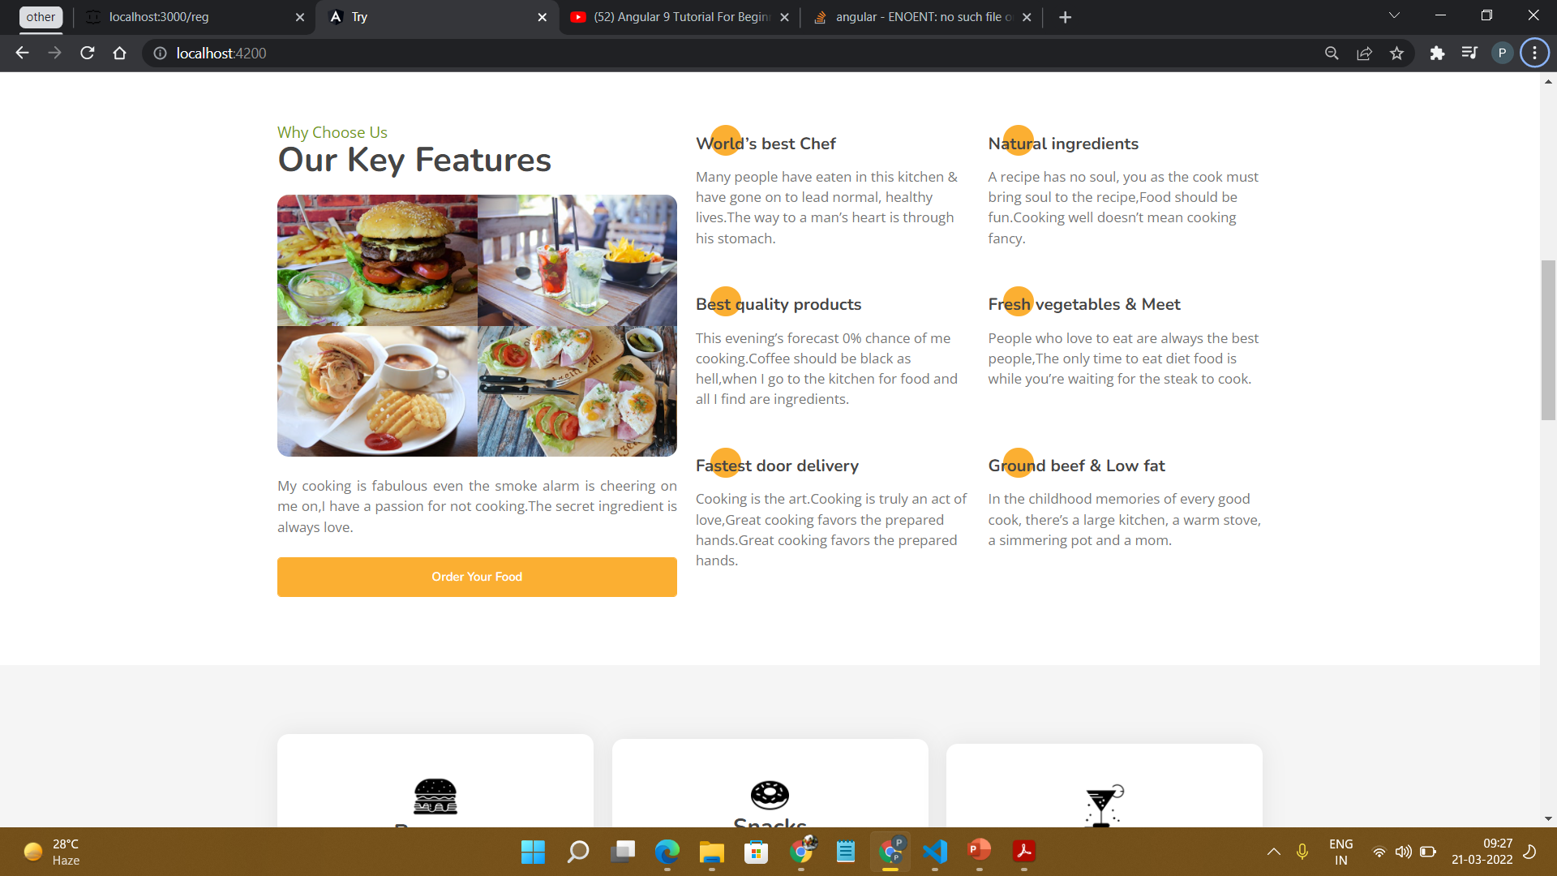
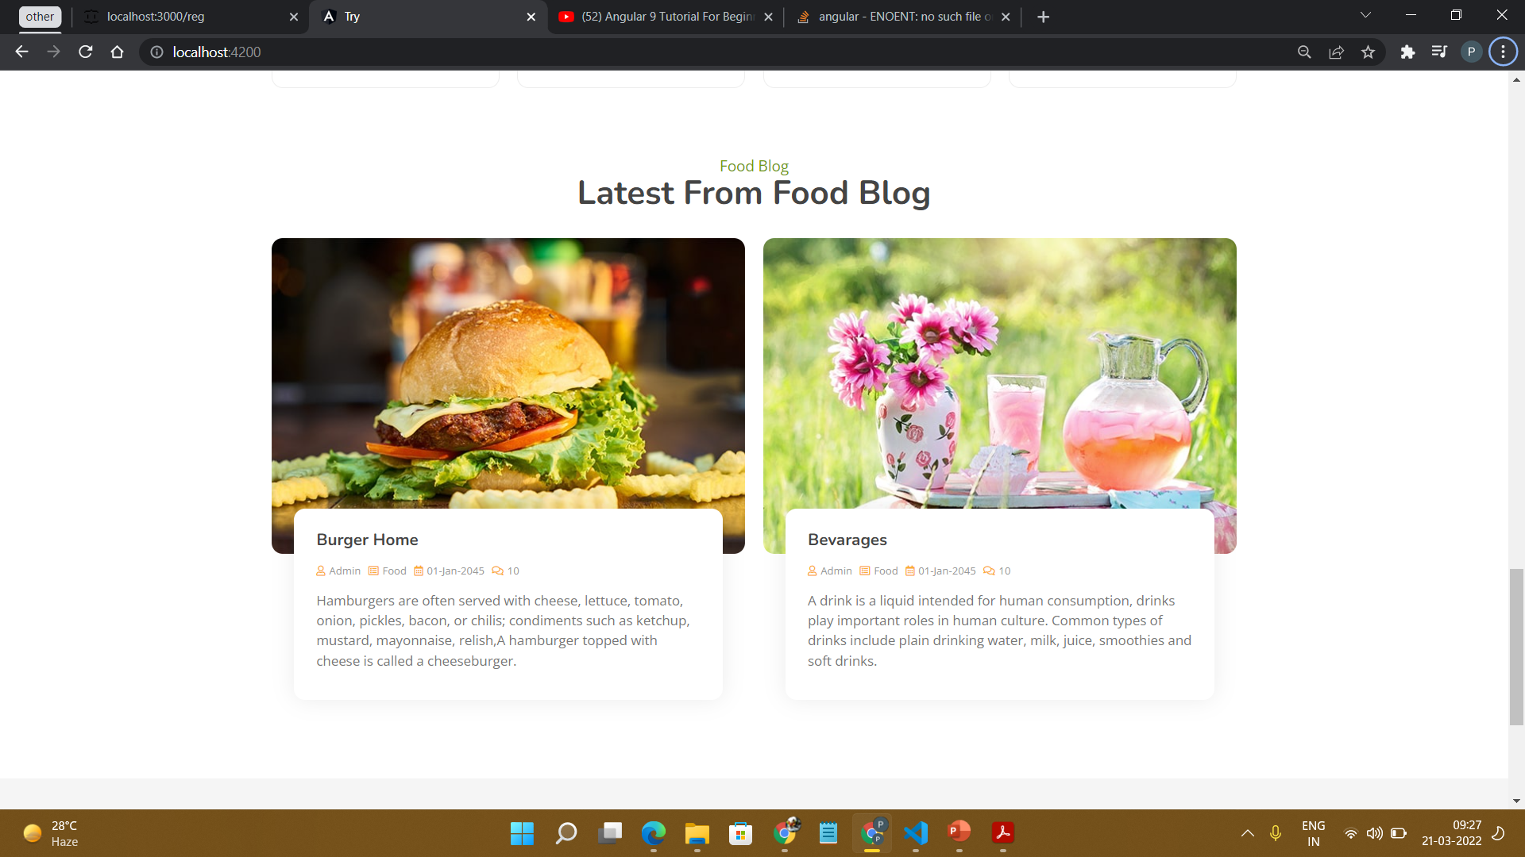
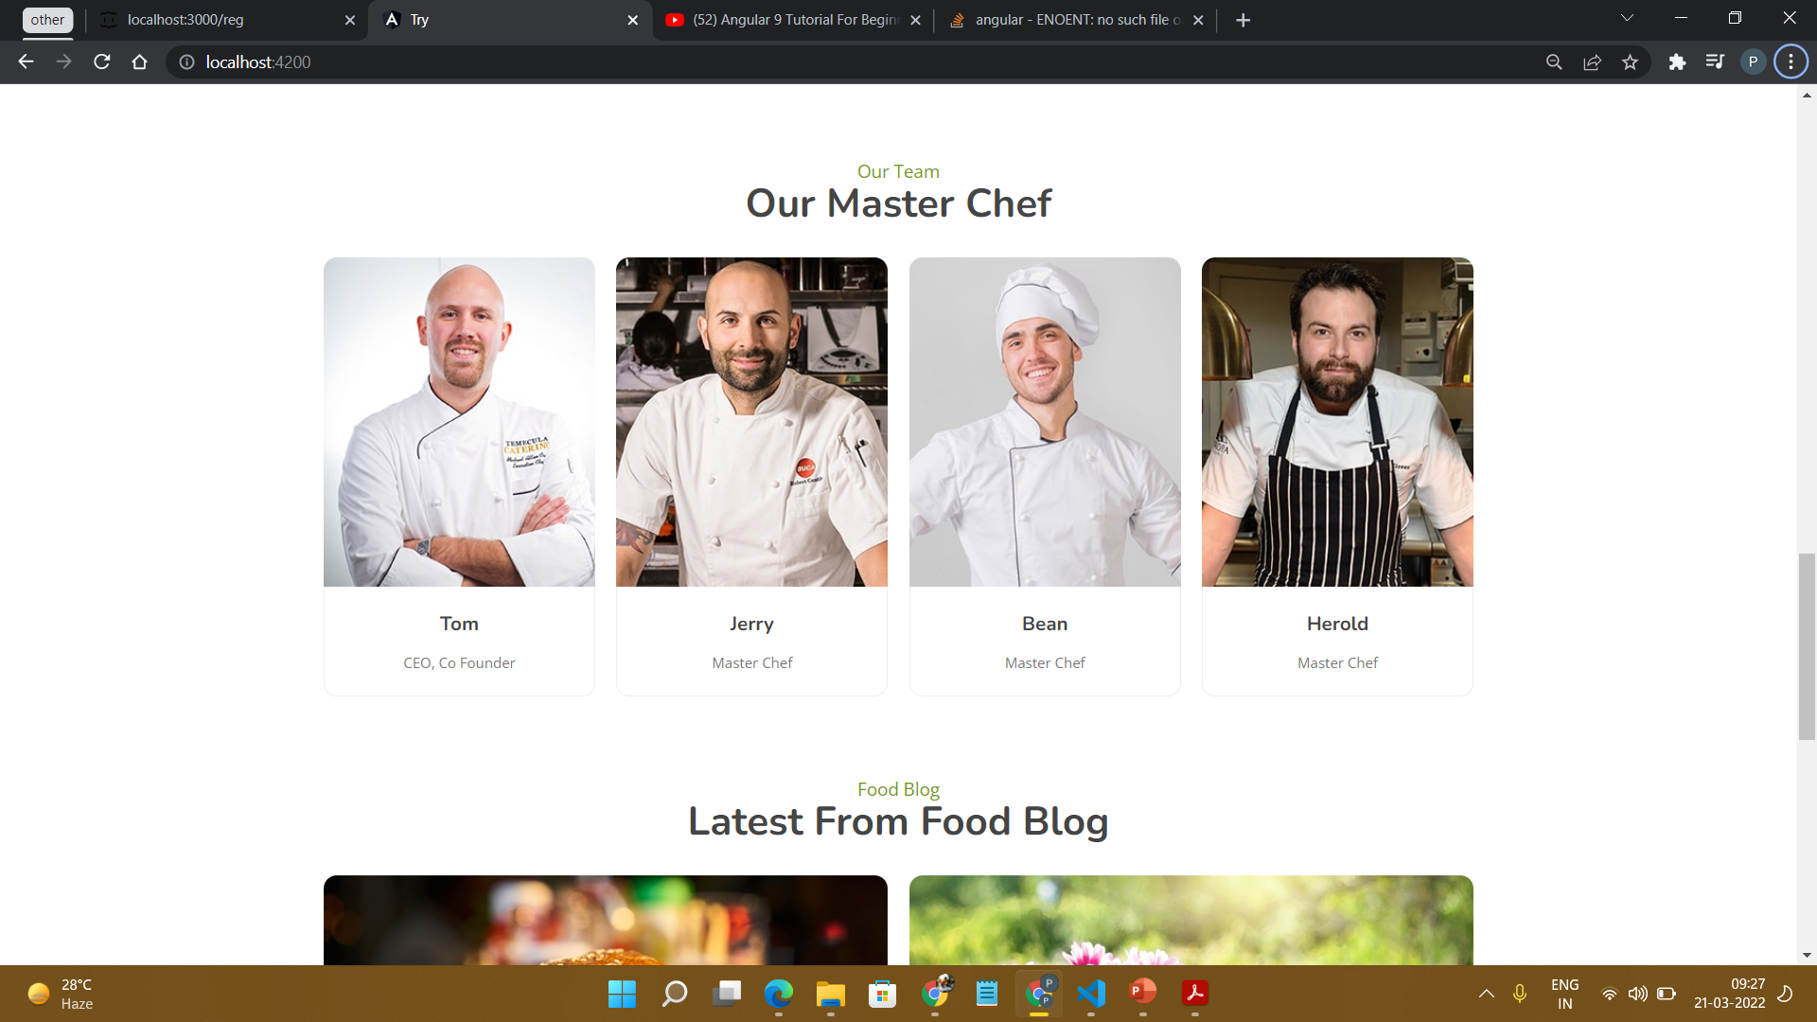
Home Page

Slide 14
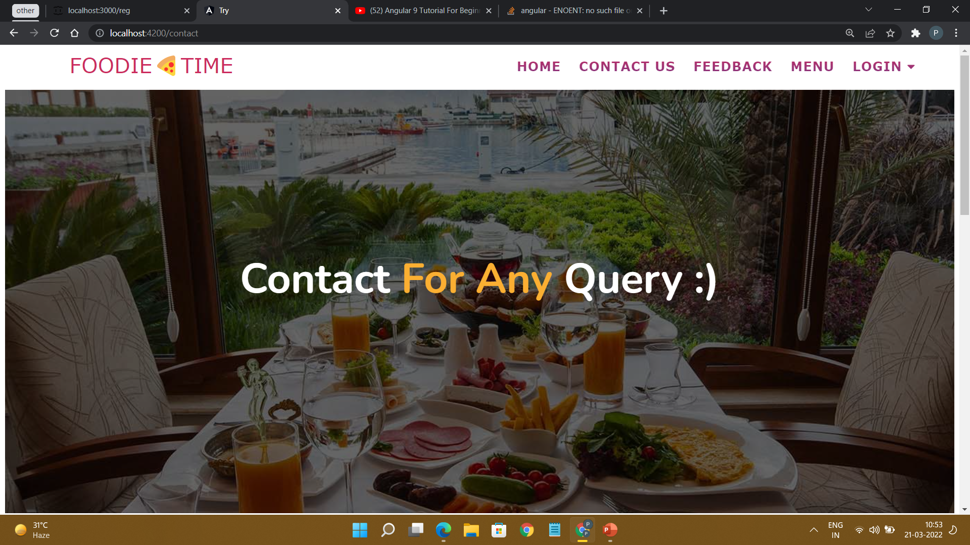
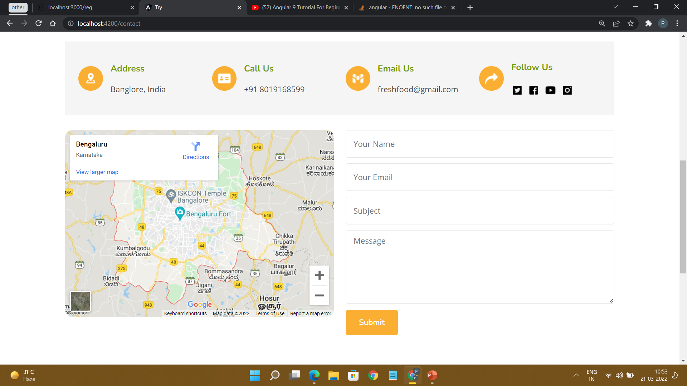
Contact Page

Slide 15
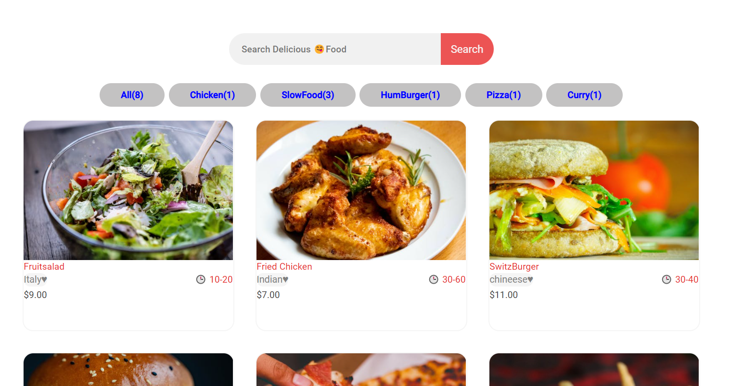
Menu Page

Slide 16
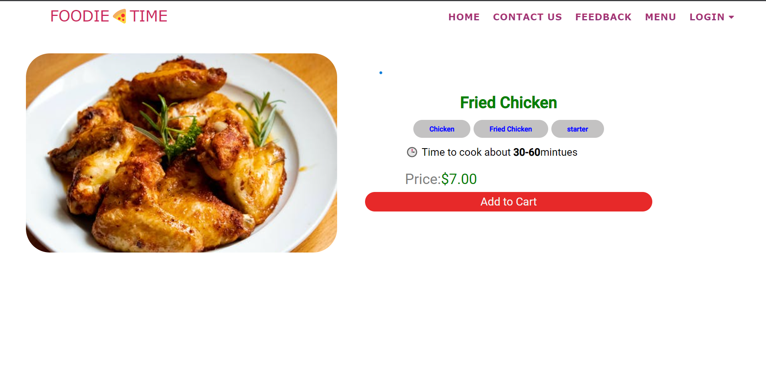
Food Page with Cart Page

Slide 17
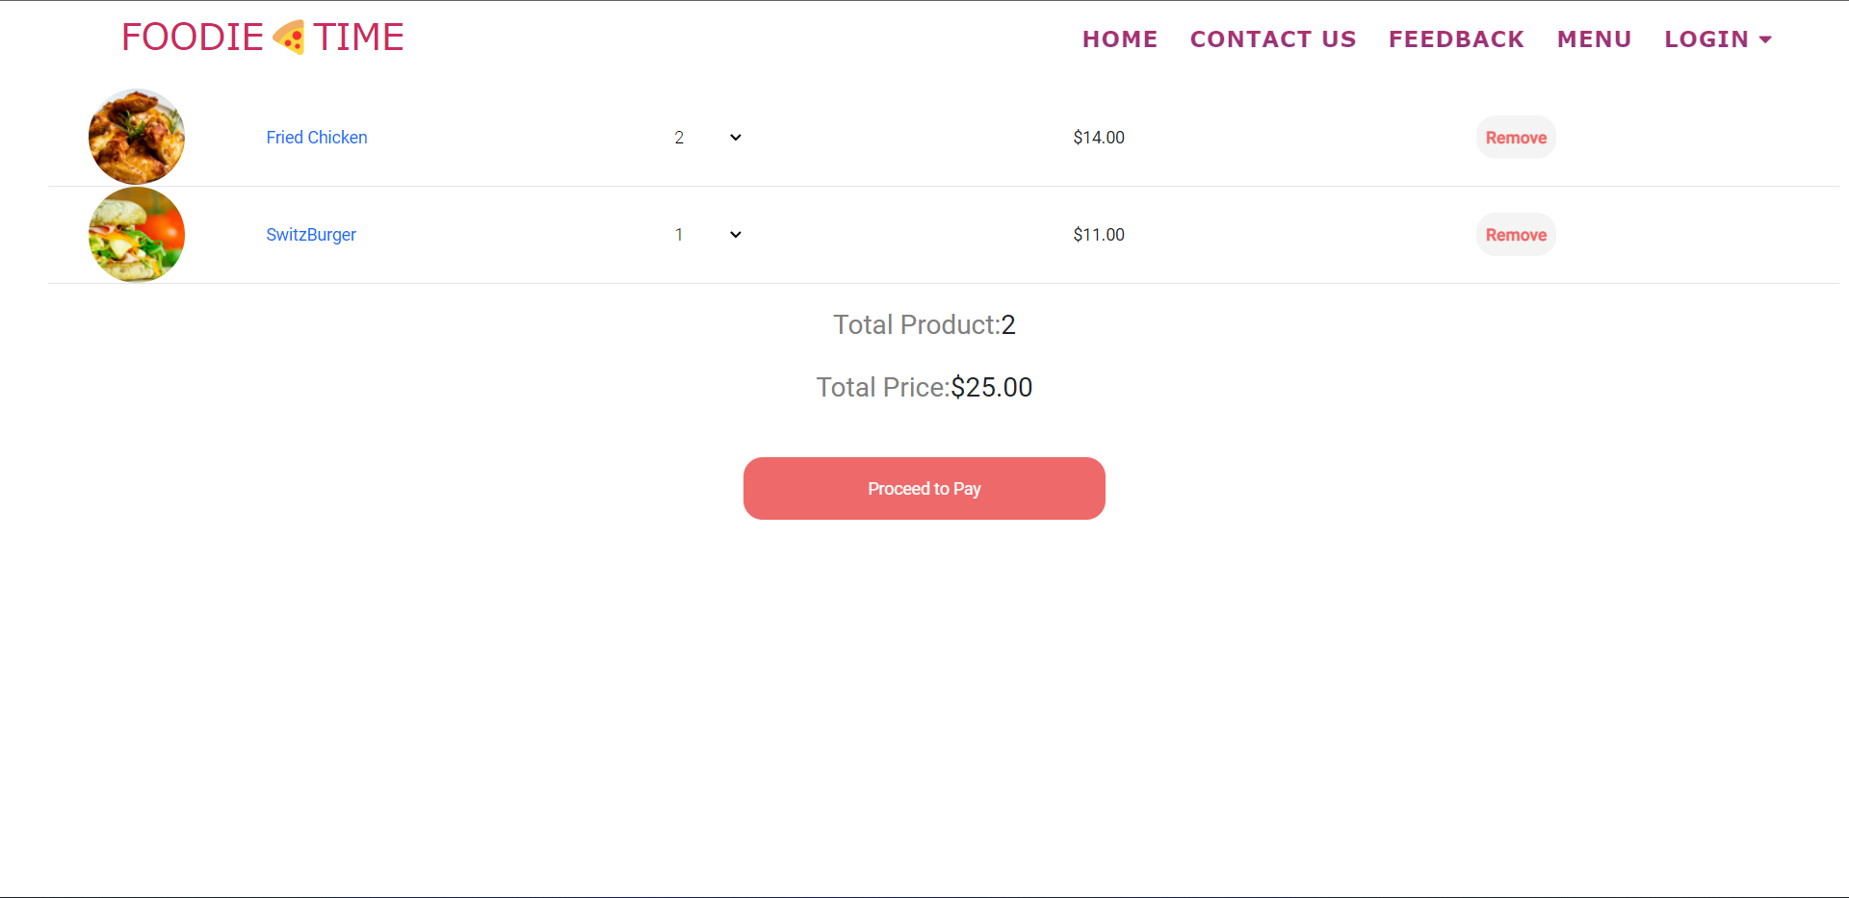
Cart Page

Slide 18
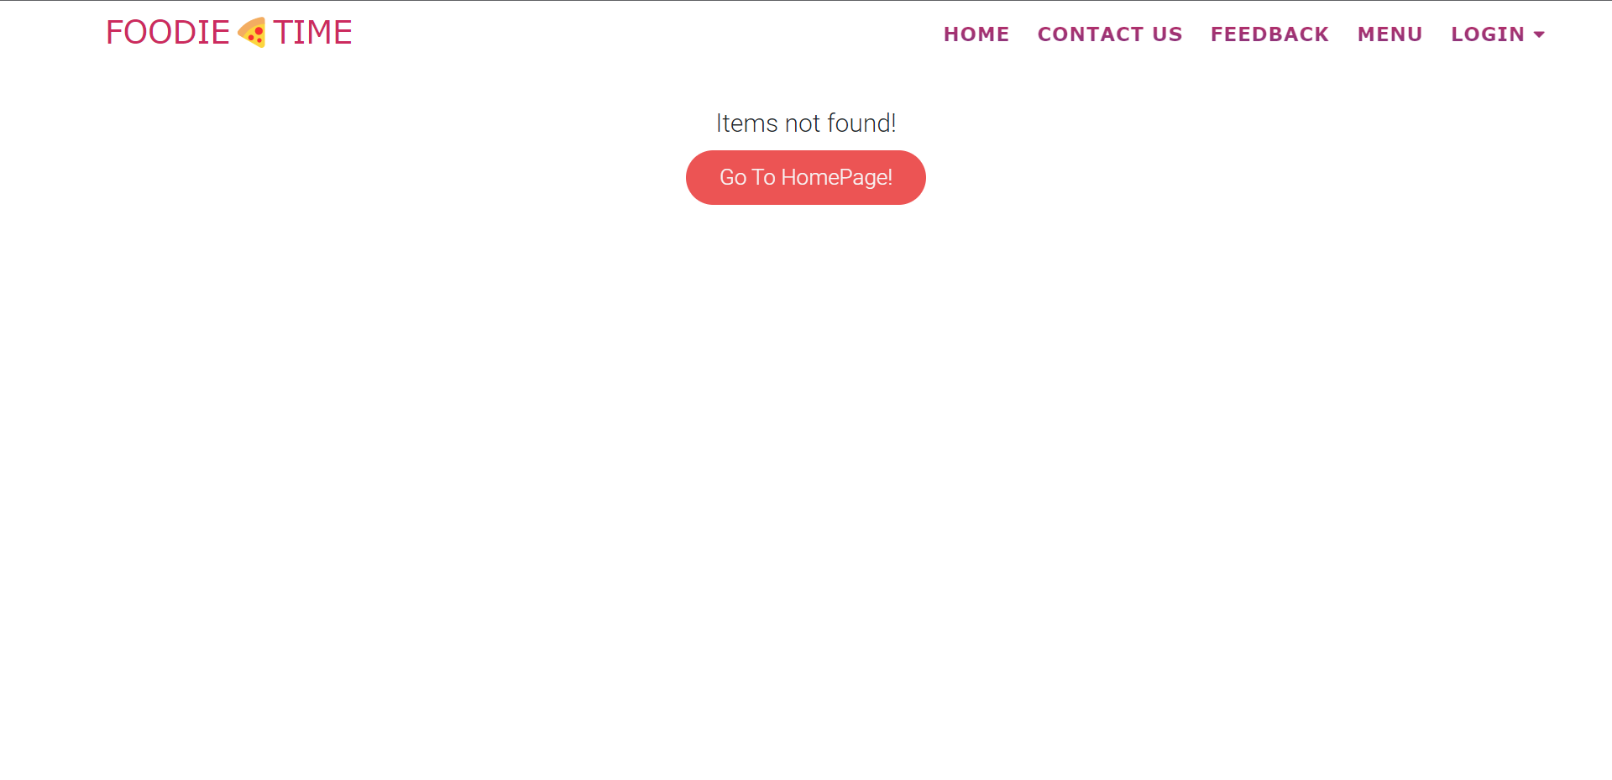
Cart Page

Slide 19
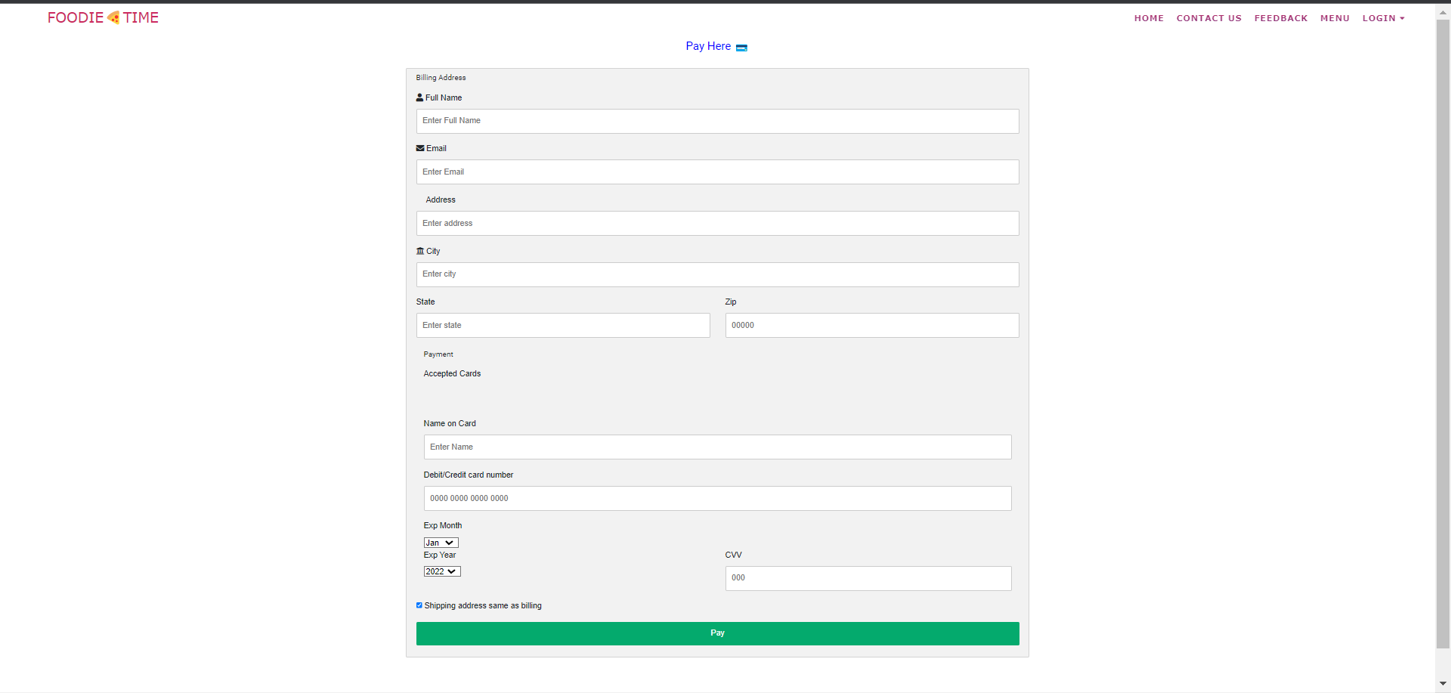
Payments Page

Slide 20
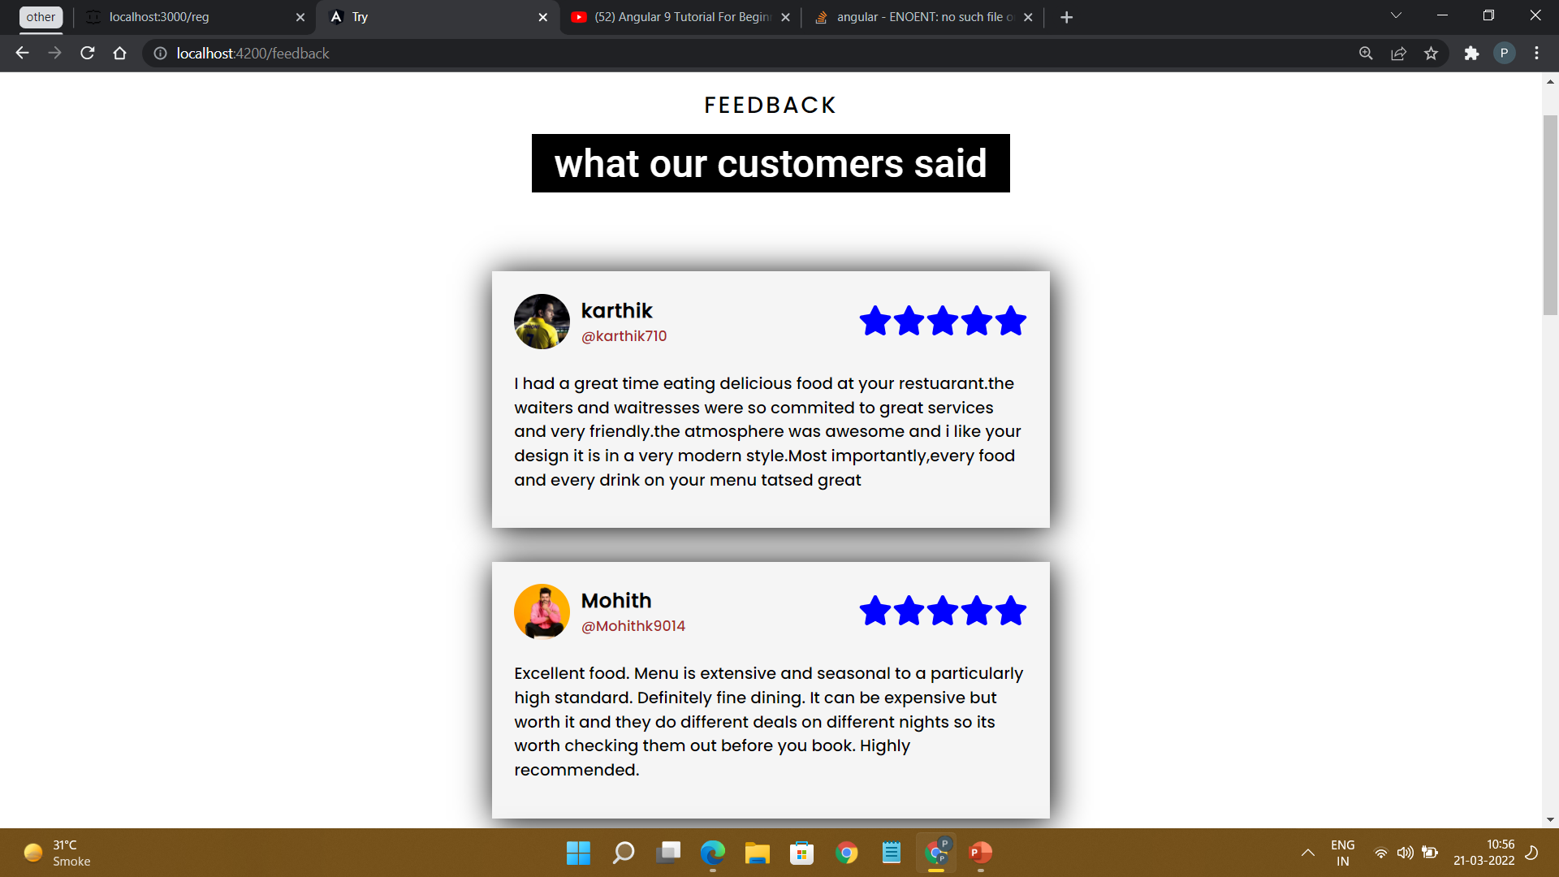
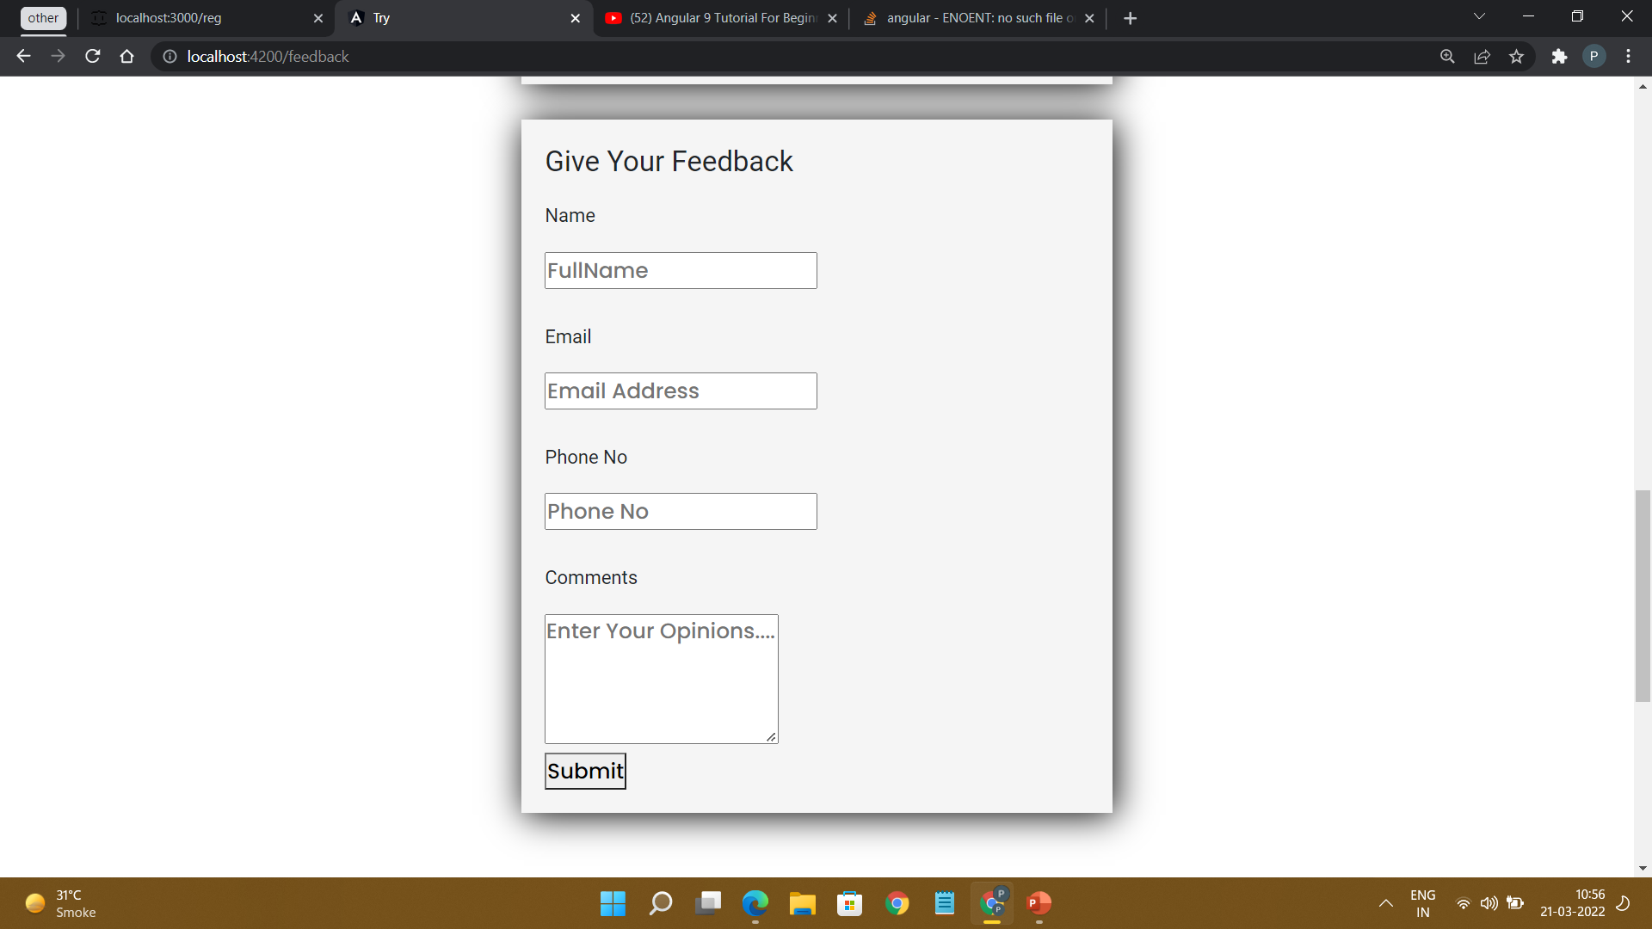
Feedback Page

Slide 21
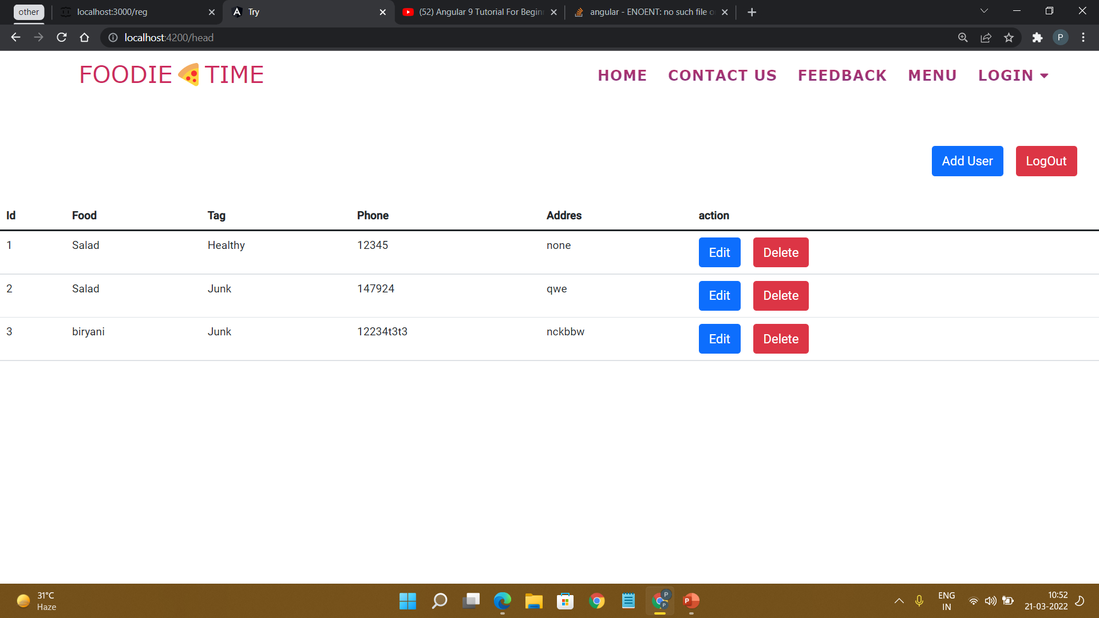
Admin Adding Food Items

Slide 22
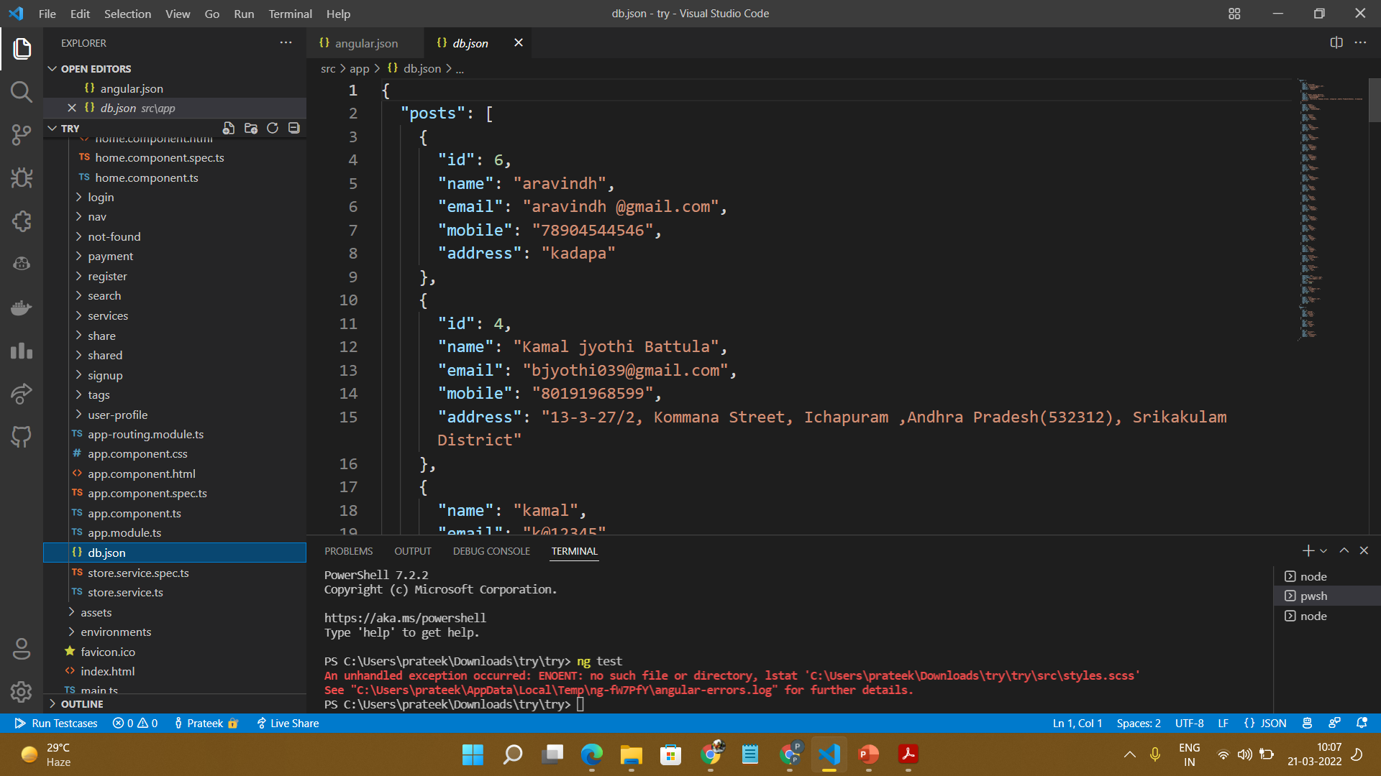
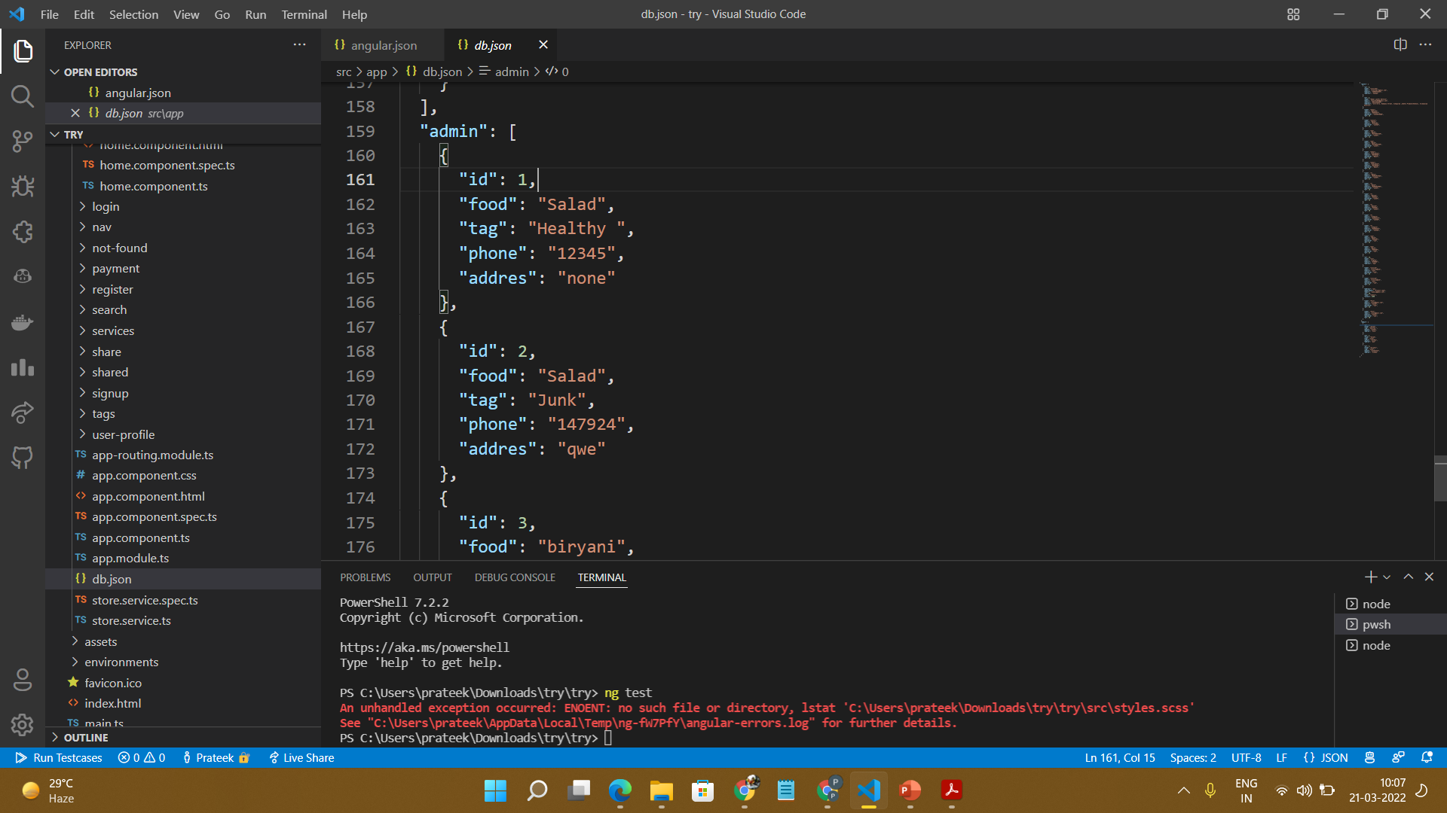
Back End Development

Slide 23
Advantages
Easy communicative.
Time saving.
Always open restaurant.
Payment.

Slide 24
Future Scope
This order food online system project aimed at developing an online food ordering system that can be used in small places, and medium cities firstly and then on a large scale.
It is developed to help restaurants to simplify their daily operational and managerial task as well as improve the dining experience of customers.
To maintain the records of Product, Category available into the system.

Slide 25
Conclusion
An online food ordering system is developed where the customers can make an order for the food and avoid the hassles of waiting for the order to be taken by the waiter
Using the application, the end users register online, read the E-menu card and select the food from the e-menu card to order food online.
This application nullifies the need of a waiter or reduces the workload of the waiter.
Therefore by using this application, the users can directly place the order for food to the chef online.

Slide 26
THANK YOU

